Slide 1

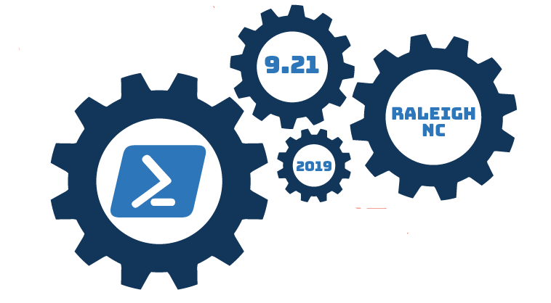
PowerShell 101: Arrays

Slide 2


Slide 3
About Your Speaker – Wes Carroll
Enterprise Architect @ Zerto
20 Years of Experience in Information Technology
Working with PowerShell Since ~2012
Get in Contact with Me
LinkedIn –/in/wes-carroll
GitHub –wcarroll
E-Mail – wcarroll@oceanbeachlife.com
Twitter – @WesCarrollTech

Slide 4
What is an Array?
An array is a data structure that is designed to store a collection of items
The items can be the same type or different types
Arrays can be strongly typed
Array size (count) is fixed at creation
Each item is assigned a static index

Slide 5
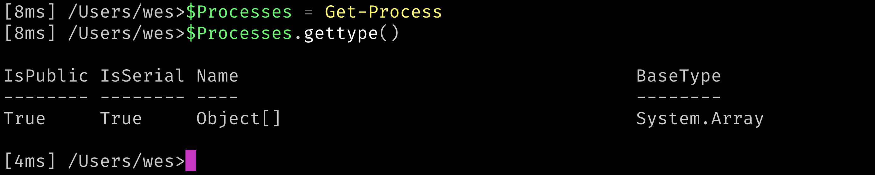
Where are Arrays Used?
Everywhere!

Slide 6
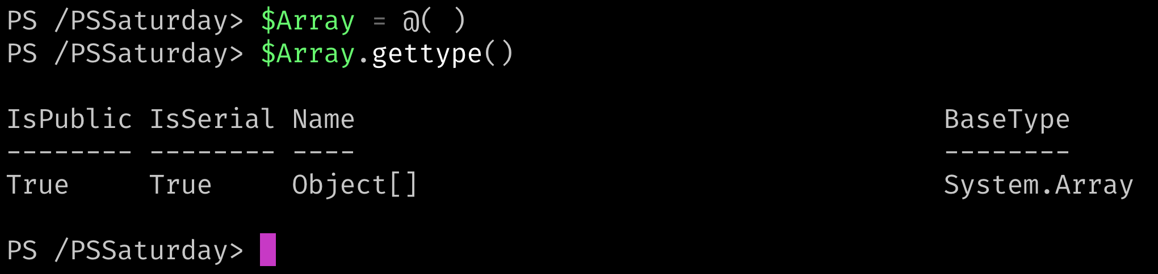
How do I Create an Array?

Slide 7
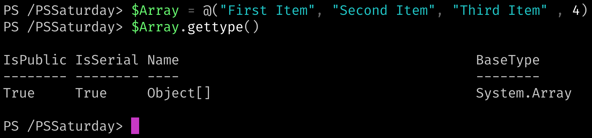
How do I Create an Array?

Slide 8
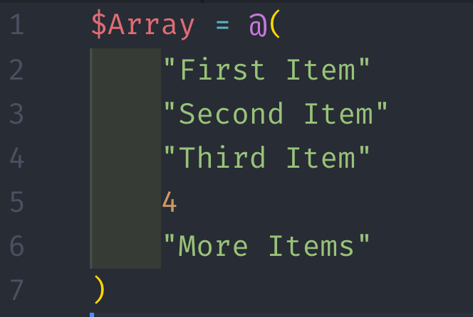
How do I Create an Array?

Slide 9
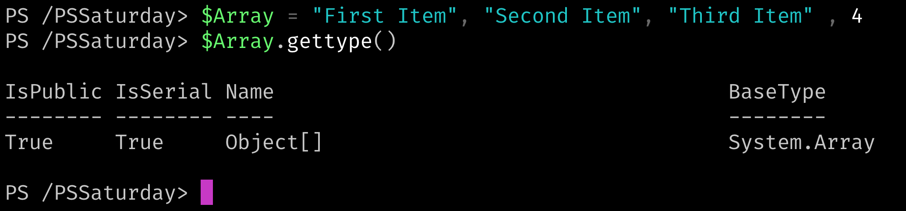
How do I Create an Array?

Slide 10
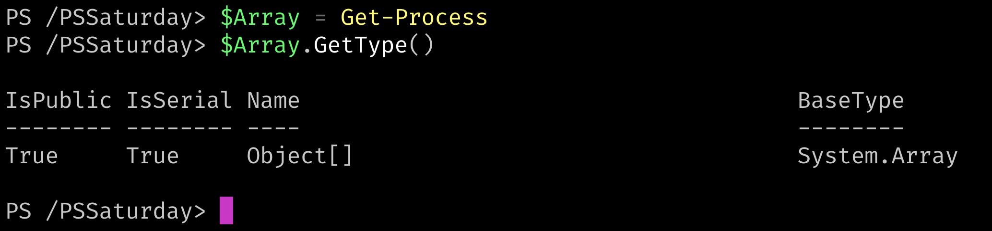
How do I Create an Array?

Slide 11
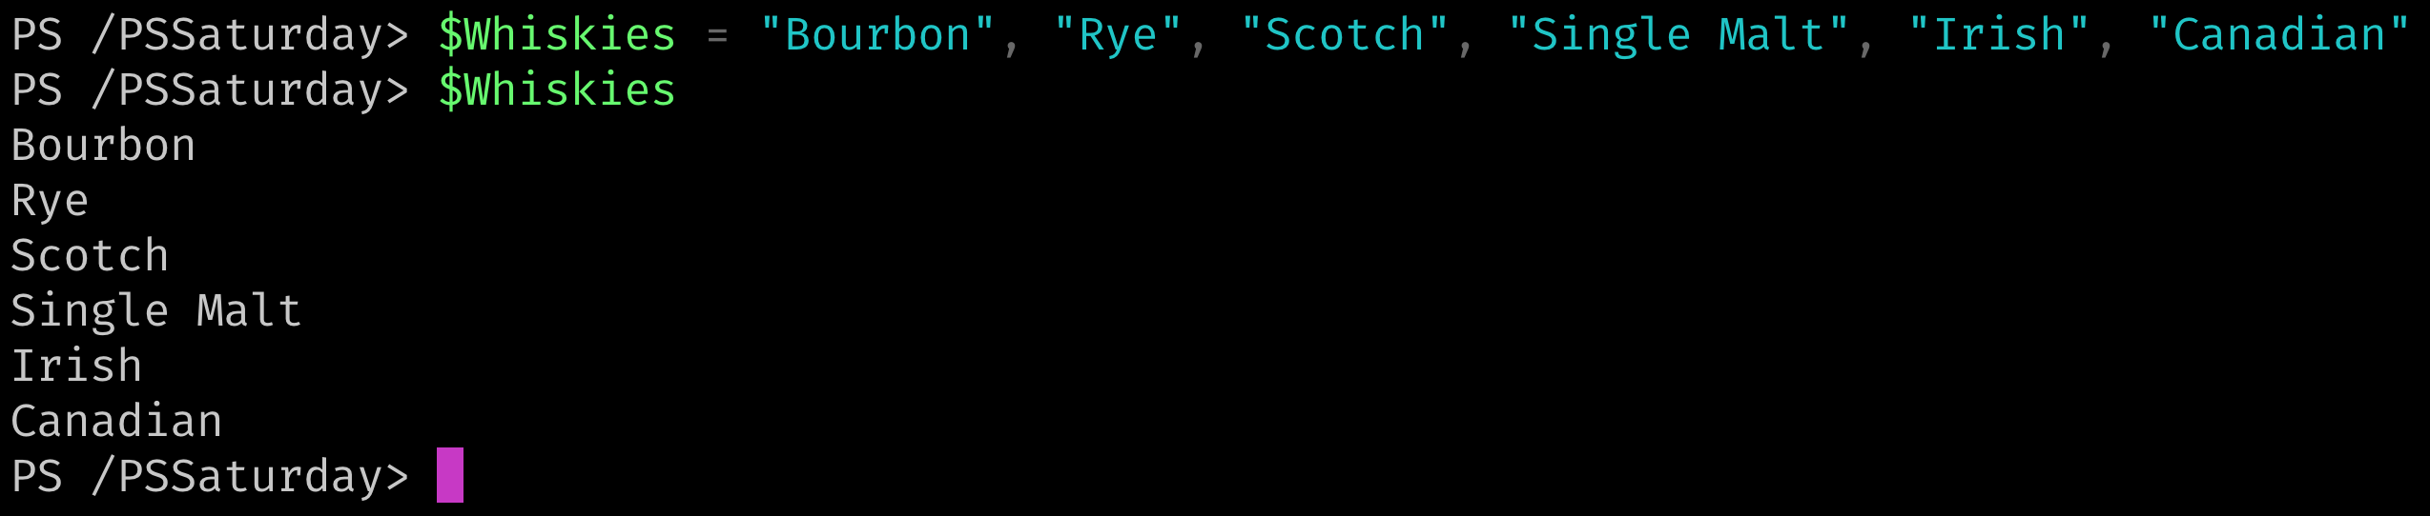
How do I Access the Data in Arrays?
Call the Variable

Slide 12
How do I Access the Data in Arrays?
The Index!
Data Element | “Bourbon” | “Rye” | “Scotch” | “Single Malt” | “Irish” | “Canadian”
Index Number | 0 | 1 | 2 | 3 | 4 | 5

Slide 13
How do I Access the Data in Arrays?
The Index!

Slide 14
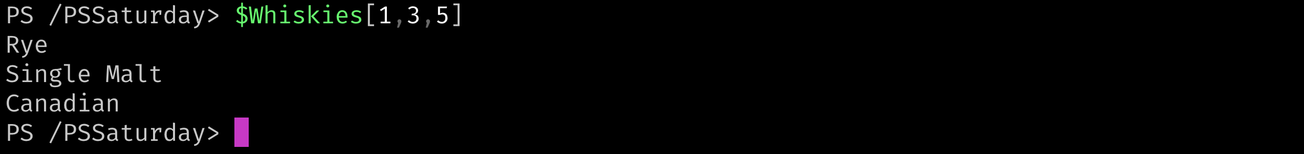
How do I Access the Data in Arrays?
The Index!

Slide 15
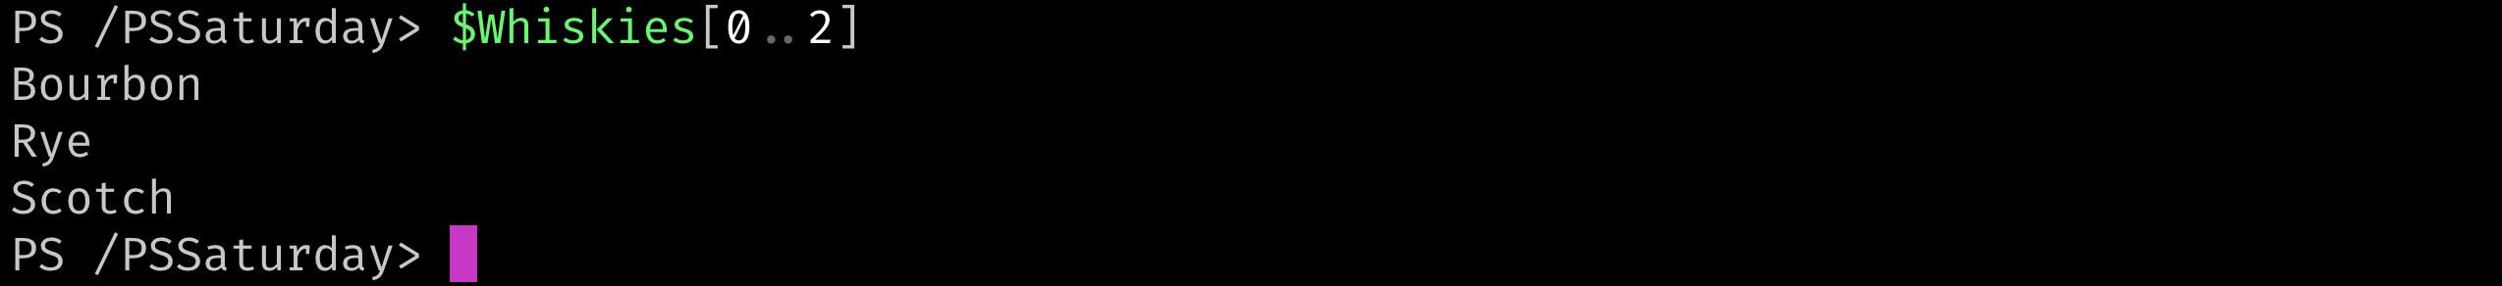
How do I Access the Data in Arrays?
The Index!

Slide 16
How do I Access the Data in Arrays?
The Index!

Slide 17
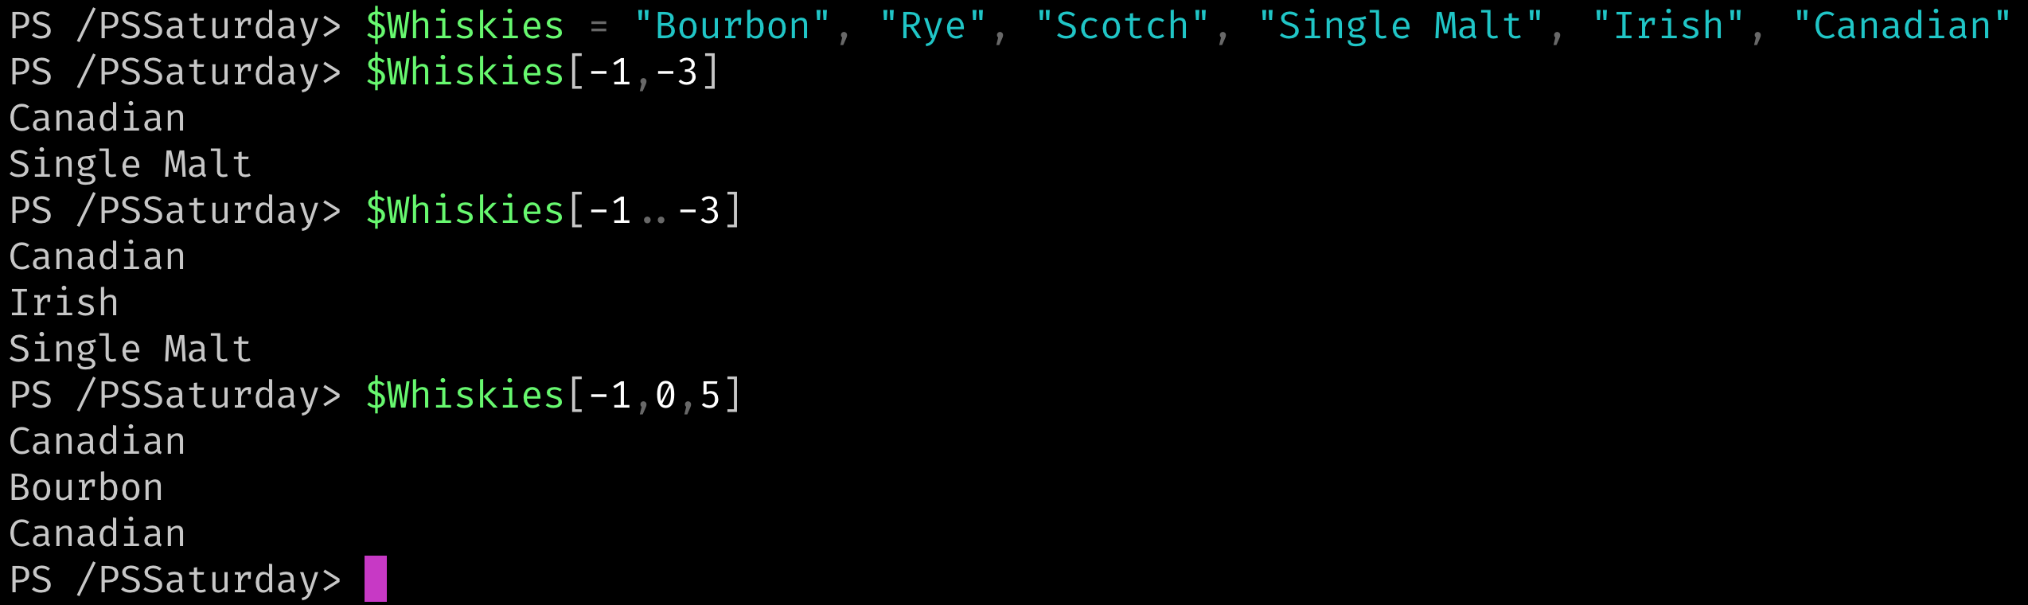
How do I Access the Data in Arrays?

Slide 18
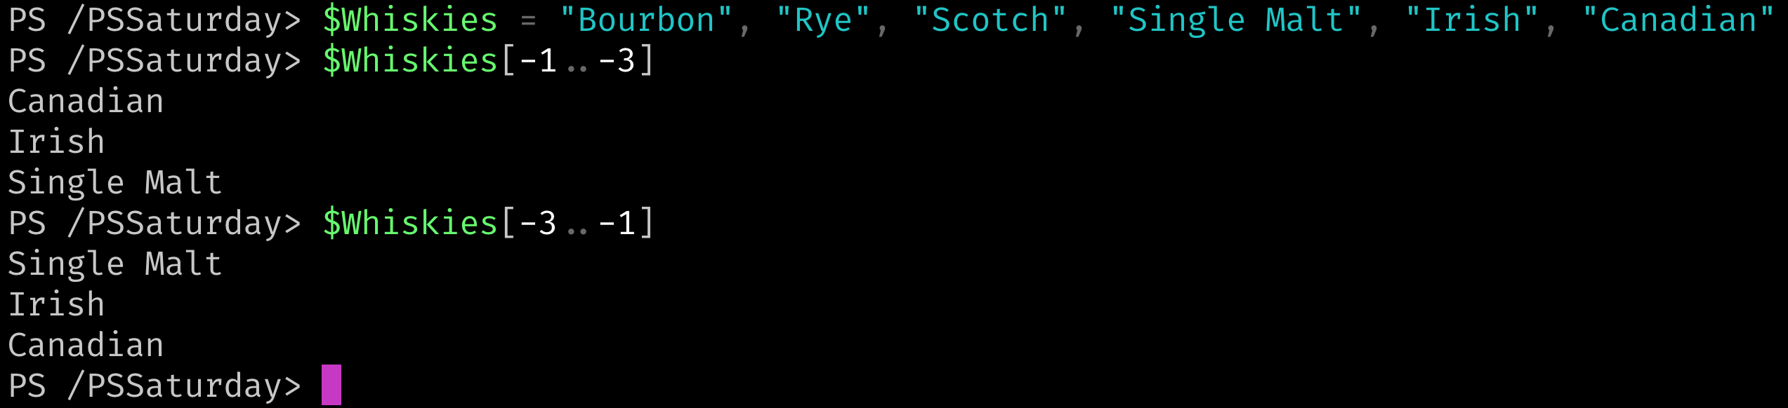
How do I Access the Data in Arrays?

Slide 19
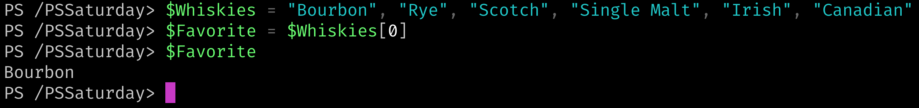
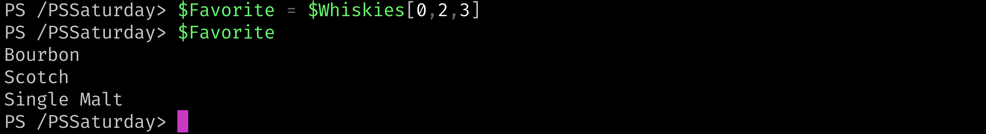
How do I Access the Data in Arrays?

Slide 20
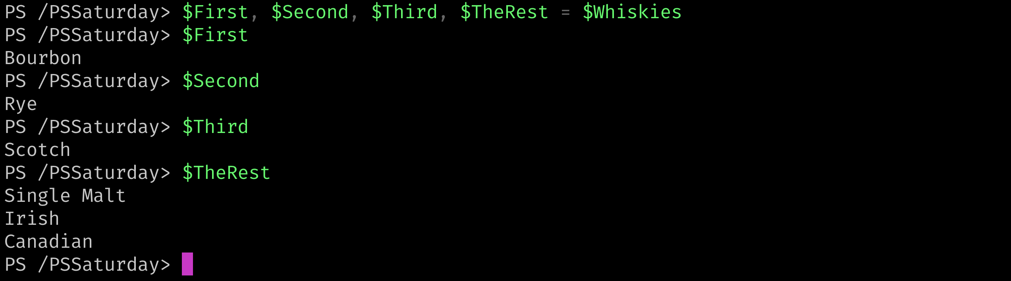
How do I Access the Data in Arrays?

Slide 21
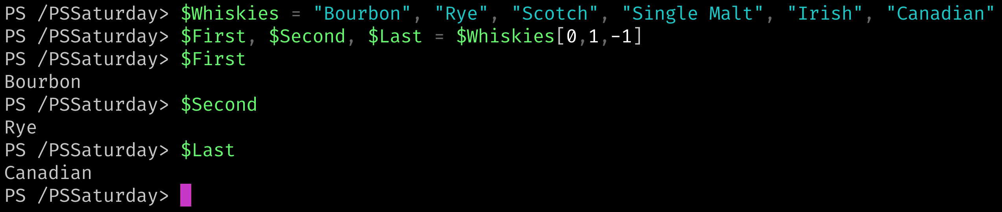
How do I Access the Data in Arrays?

Slide 22
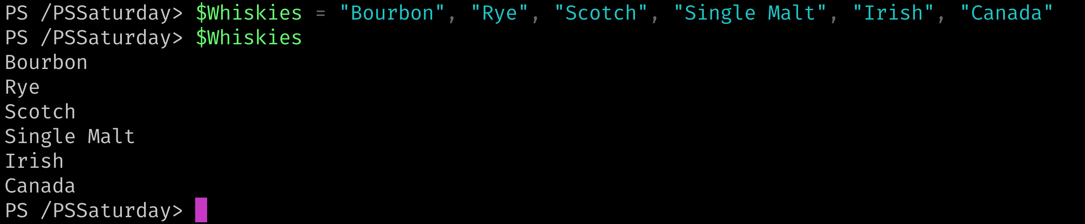
How do I Change the Data in Arrays?

Slide 23
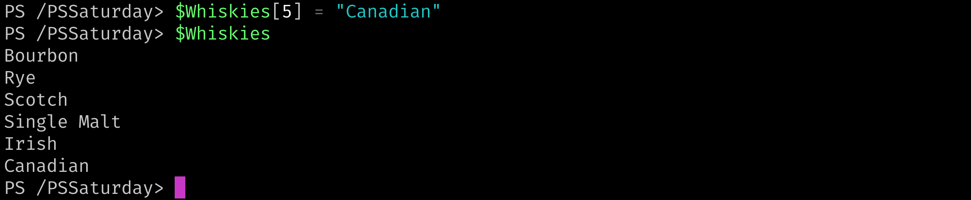
How do I Change the Data in Arrays?
The Index!

Slide 24
How do I Iterate Through the Array?
Foreach-Object (via the Pipeline)
Foreach Loop
Foreach Method
Switch Loop
For Loop

Slide 25
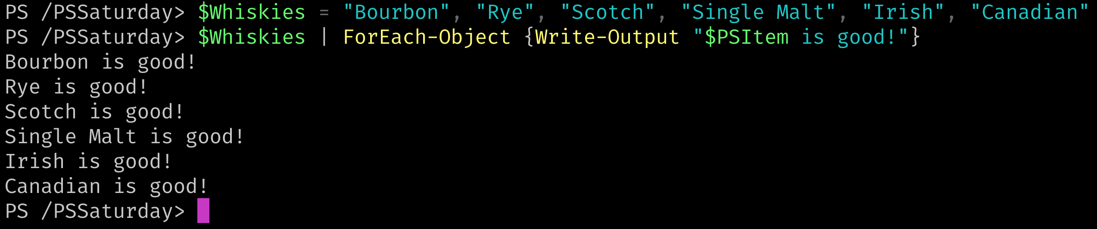
How do I Iterate Through the Array?
Foreach-Object (via the Pipeline)

Slide 26
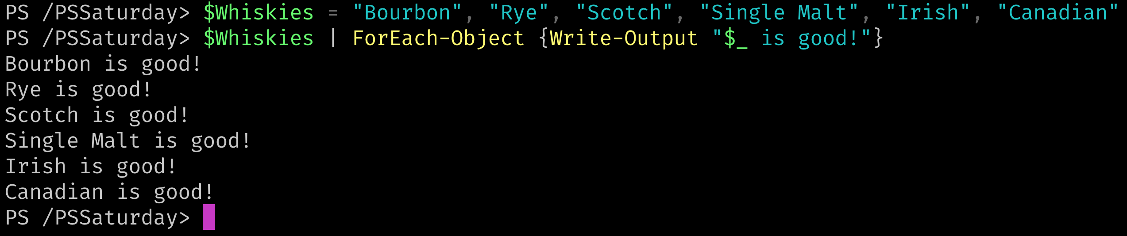
How do I Iterate Through the Array?
Foreach-Object (via the Pipeline)

Slide 27
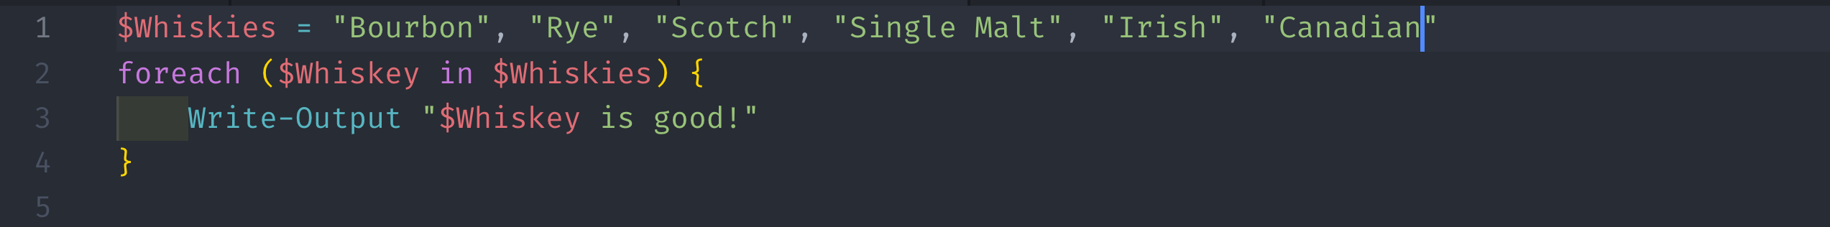
How do I Iterate Through the Array?
Foreach Loop

Slide 28
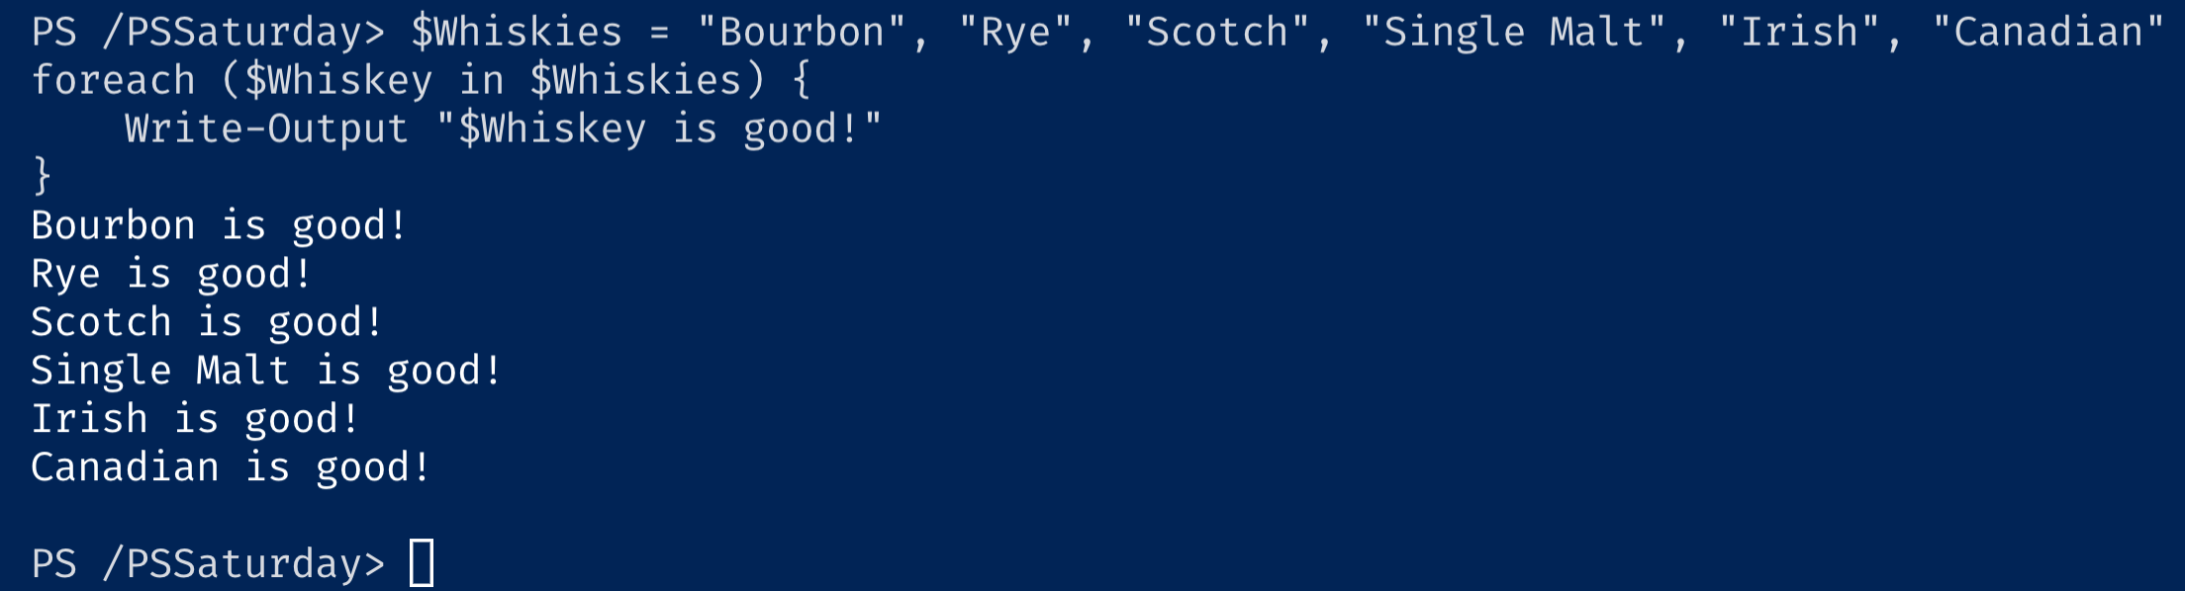
How do I Iterate Through the Array?
Foreach Loop

Slide 29
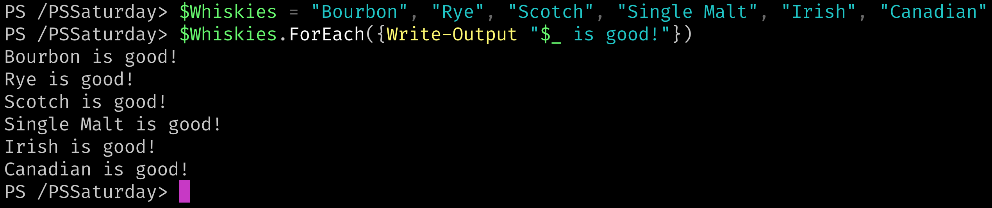
How do I Iterate Through the Array?
Foreach Method

Slide 30
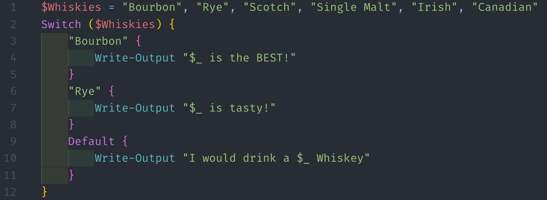
How do I Iterate Through the Array?
Switch Loop

Slide 31
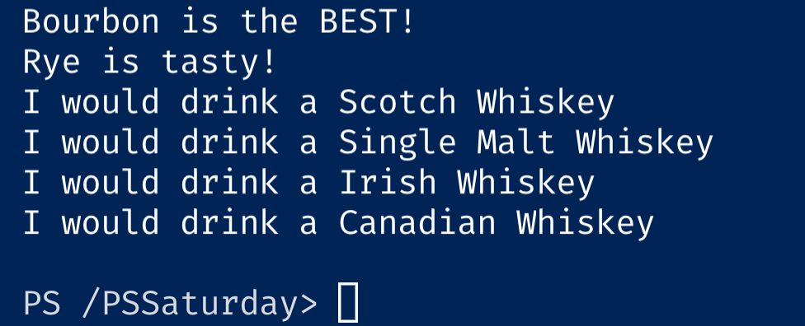
How do I Iterate Through the Array?
Switch Loop

Slide 32
How do I Filter Arrays?
Where-Object (Pipeline)
Where Method

Slide 33
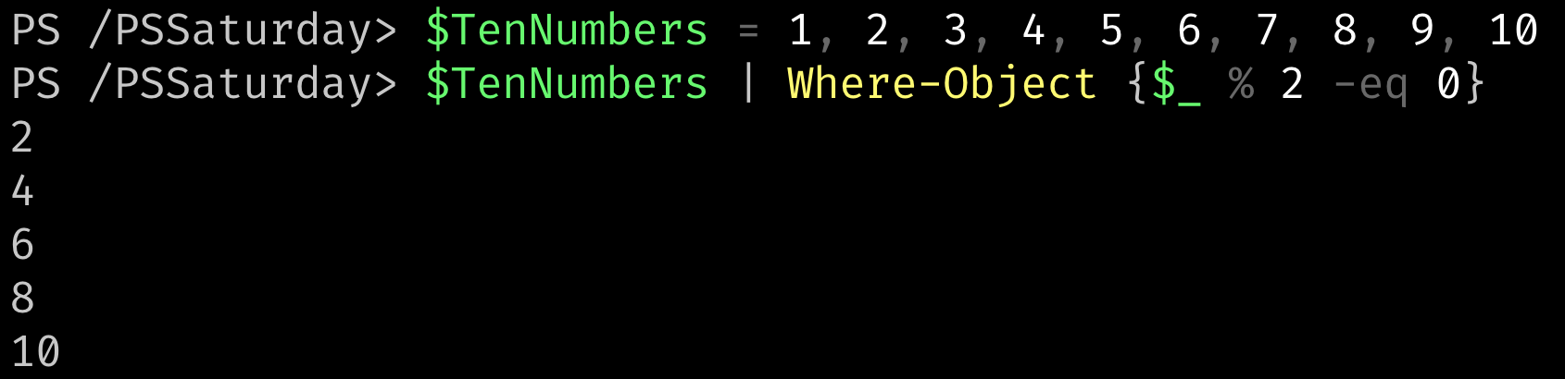
How do I Filter Arrays?
Where-Object

Slide 34
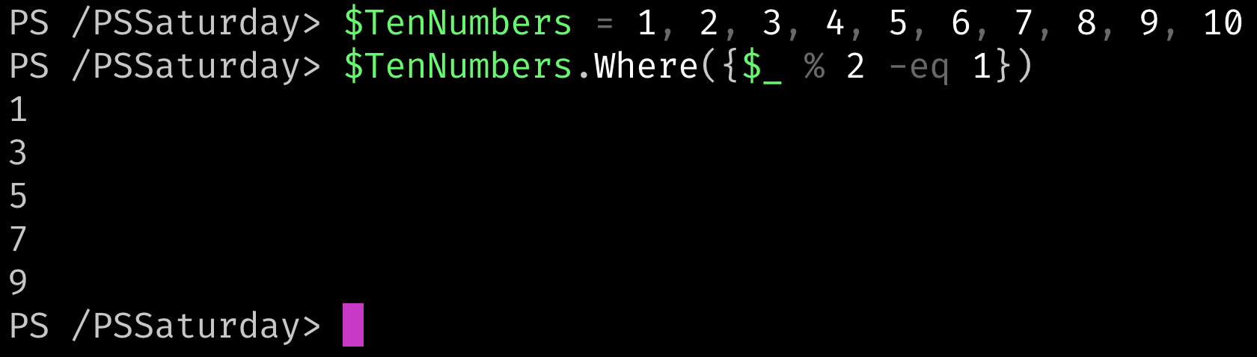
How do I Filter Arrays?
Where Method

Slide 35
How do I Remove Data from Arrays?
You don’t*
Data inside of Arrays can be updated but individual items cannot be removed
Using logic, you can create a new array

Slide 36
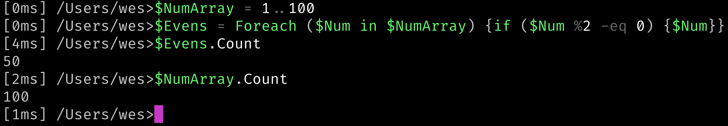
How do I Remove Data from Arrays?
Using logic, you can create a new array

Slide 37
How do I Add Data to Arrays?
You don’t*
Data inside of Arrays can be updated but increasing the size (count) of the array is not possible
Wes, I think you are forgetting about the “+=” operator

Slide 38

How do I Add Data to Arrays?

Slide 39
What is Wrong with the “+=” Operator?
Array plus equals operation is expensive
Negatively impacts performance

Slide 40
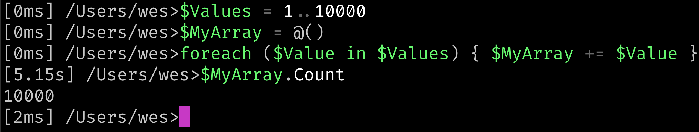
What is Wrong with the “+=” Operator?

Slide 41
What is Wrong with the “+=” Operator?
Array Size | Seconds Elapsed
10000 | 5.2
20000 | 22.6
30000 | 51.1
40000 | 93.7
50000 | 144.2
60000 | 203.8
70000 | 281.3
80000 | 366.5
90000 | 462
100000 | 568.8

Slide 42
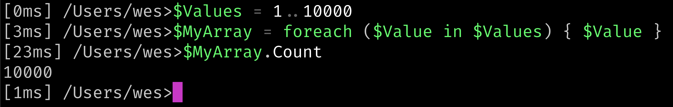
How do I Build a Dynamically Sized Array?

Slide 43
How do I Build a Dynamically Sized Array?
Array Size | Seconds Elapsed
10000 | 0.024
20000 | 0.059
30000 | 0.066
40000 | 0.082
50000 | 0.112
60000 | 0.123
70000 | 0.157
80000 | 0.17
90000 | 0.19
100000 | 0.211

Slide 44
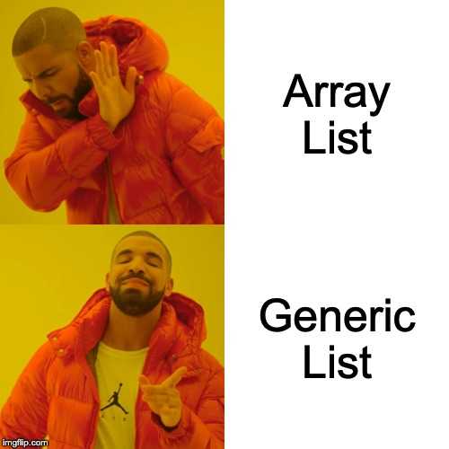
What if we NEED to Add and Remove?

Slide 45
What if we NEED to Add and Remove?
Array Lists [System.Collections.ArrayList] ==> This is depreciated
Generic Lists [System.Collections.Generic.List<type>]
PS > $NewArray = [System.Collections.Generic.List[string]]::new()
PS > $NewArray = [System.Collections.Generic.List[int]]::new()
PS > $NewArray = [System.Collections.Generic.List[PSObject]]::new()

Slide 46
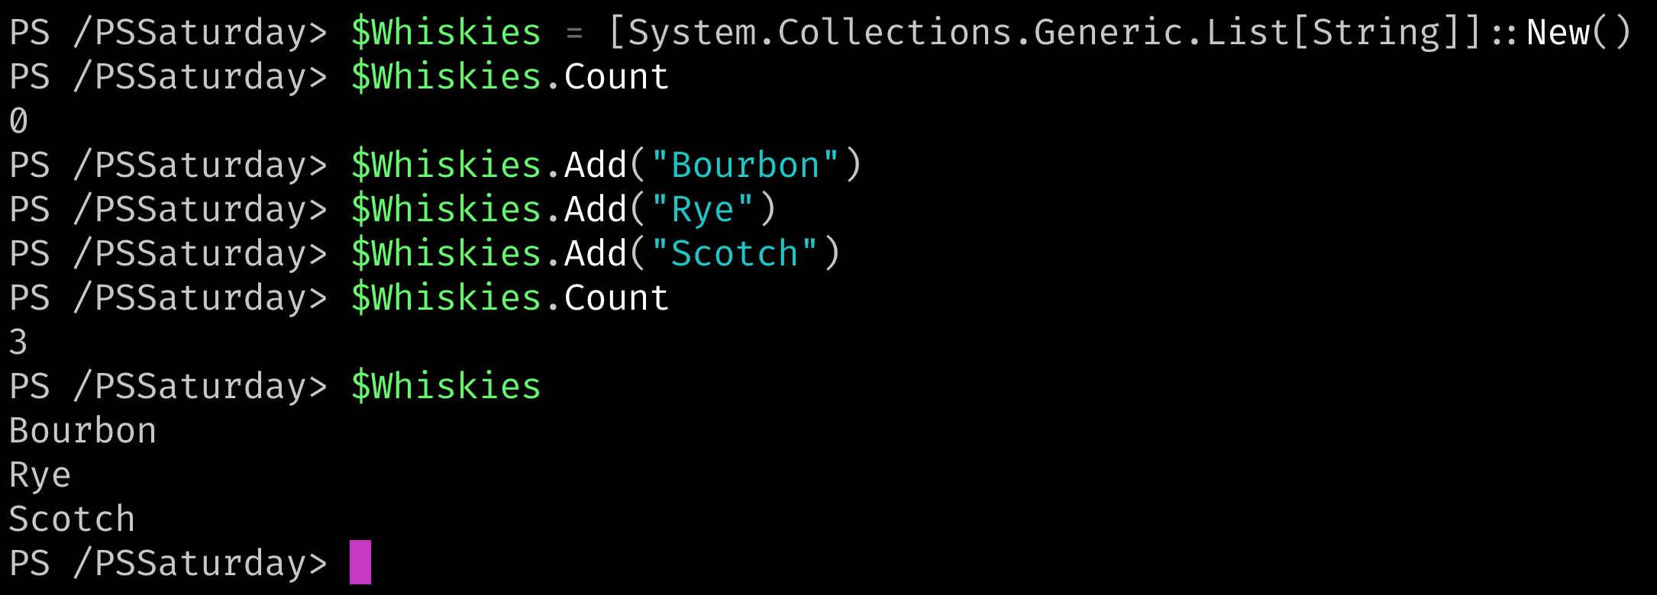
What if we NEED to Add and Remove?

Slide 47
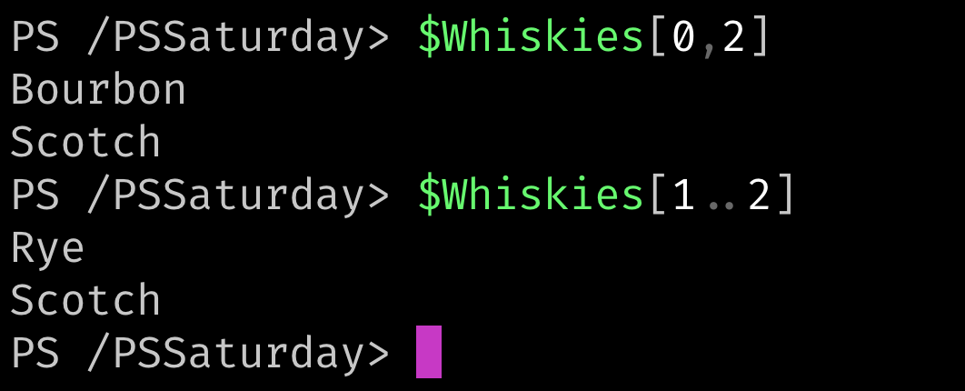
What if we NEED to Add and Remove?

Slide 48
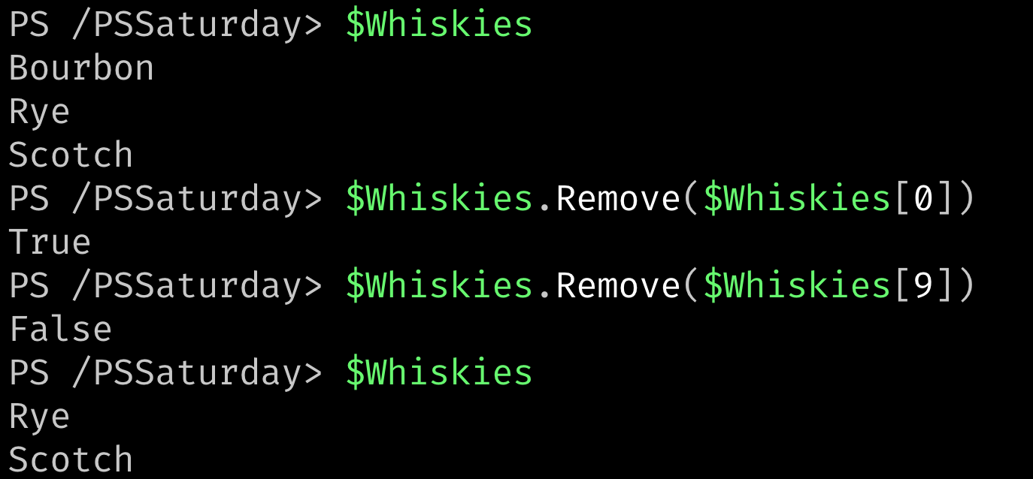
What if we NEED to Add and Remove?

Slide 49
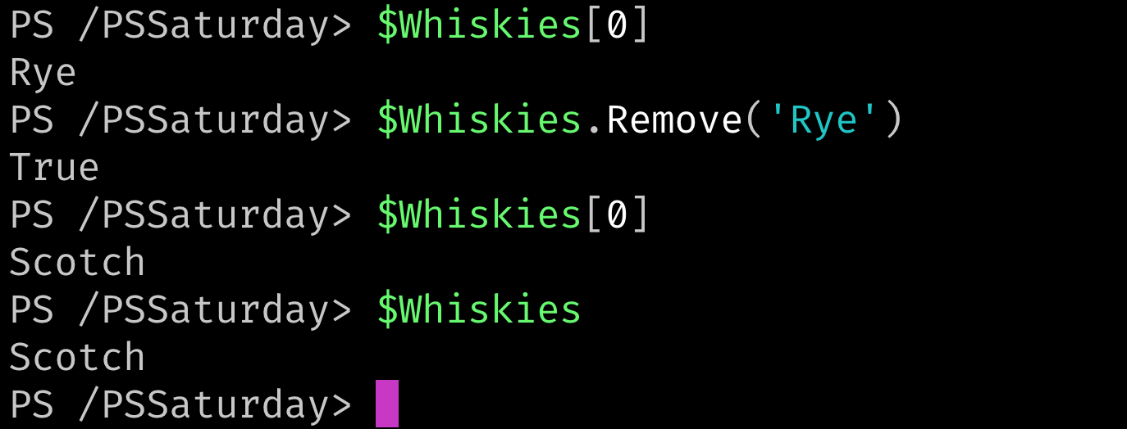
What if we NEED to Add and Remove?

Slide 50
What Did You Leave Out?
Comparison Operators
Equals
Not Equals
Contains
In
Match
Replace
Split

Slide 51
Resources!
Get-Help about_arrays
PowerShell Explained – All About Arrays by Kevin Marquette
https://ss64.com/ps/syntax-arrays.html
PowerShell in a Month of Lunches – Don Jones & Jeffrey Hicks
PSKoans - https://github.com/vexx32/PSKoans

Slide 52
Q&A

